Slide 1
FLOTILLA ELECTED LEADER ACADEMY
Division 114-07 Channel Islands
Saturday November 23, 2024

Slide 2
Introductions

Slide 3
FELA Today’s Highlights
Leader Responsibilities
Administrative Procedures / Policy
Membership Mentoring & HR
Flotilla & Member Evaluation

Slide 4
Sharing the Vision

Slide 5
A SHARED VISION unites and provides a common goal for groups of people. A SHARED VISION has an unlimited amount of people power once tapped!

Slide 6
Mission
To promote and improve recreational boating safety;
To provide a diverse array of specialized skills, trained crews, and capable facilities to augment the Coast Guard and enhance safety and security of our ports, waterways, and coastal regions; and,
To support Coast Guard operational, administrative, and logistical requirements.

Slide 7
The Vision
“The U.S. Coast Guard Auxiliary – the best trained, most valued maritime volunteer organization in the world – highly effective during normal operations and ready for emergencies.”
We Do What We Do.. To Save Lives

Slide 8
Core Values
Honor – Integrity is our standard. We demonstrate uncompromising ethical conduct and moral behavior in all of our personal and organizational actions. We are loyal and accountable to the public trust.
Respect – We value our diverse membership. We treat each other and those we serve with fairness, dignity, respect, and compassion. We encourage individual opportunity and growth. We encourage creativity through empowerment. We work as a team.
Devotion to Duty – We are volunteers who seek responsibility, accept accountability, and are committed to the successful achievement of our organizational goals. We exist to serve. We serve with pride.

Slide 9
A Story
Painting the Ship

Slide 10
Now, let’s look at the Coast Guard’s example of a SHARED VISION
A BM2 takes a working party of three SNs to paint their CG Cutter. All three SNs have the same paint, brush and instructions to paint their assigned area.
SN#1 paints bow; SN#2 mid ships; SN#3 stern

Slide 11
the Coast Guard’s example of a SHARED VISION
Two hours later, the BM2 comes back to inspect the work. He askes each SN the same question:

Slide 12
the Coast Guard’s example of a SHARED VISION
“SN#1-- What are you doing?”
SN#1 says: “I’m painting the bow BM2!”

Slide 13
the Coast Guard’s example of a SHARED VISION
“SN#2-- What are you doing?”
SN#2 says: “I’m Saving the Cutter BM2!”

Slide 14
the Coast Guard’s example of a SHARED VISION
“SN#3-- What are you doing?”
SN#3 says: “I’m Saving LIVES BM2!”

Slide 15
the Coast Guard’s example of a SHARED VISION
Three different answers for the same job?
Why is that?

Slide 16
the Coast Guard’s example of a SHARED VISION
The differences are the attitude and understanding of the role each SN plays in one of the main missions of the Coast Guard
SAVING LIVES!

Slide 17
the Coast Guard’s example of a SHARED VISION
The SHARED VISION of keeping the Cutter ready and seaworthy to Save Lives was
totally understood by SN#3.
He knew his painting was “Saving Lives”.

Slide 18
the Coast Guard’s example of a SHARED VISION
SN#2 had an understanding that the
Cutter had to be seaworthy.
He KNEW his painting was “saving the Cutter”.

Slide 19
the Coast Guard’s example of a SHARED VISION
SN#1 only understood it was
supposed to be painted
“white”

Slide 20
the Coast Guard’s example of a SHARED VISION
This may work for a Cutter’s working party
BUT, how does this apply in
The Auxiliary?

Slide 21
The Auxiliary should have all members understand what they do contributes to “Saving Lives”
Let’s look at our three SNs as three Auxiliarists; all three pay their dues and get uniforms and are excited about joining --- then this happens…
Member #1 does not show up for anything
Member #2 only goes to Flotilla meetings
Member 3 gets certified, holds office, goes to meetings, and attends this workshop

Slide 22
We Do What We Do To Save Lives
It is your job as Flotilla leaders to have your members understand that any job they do “Saves Lives”.
We all joined the Auxiliary for some reason. All of you in this room stayed true to why you joined.
However, some Aux members have lost touch with their reason(s) due to circumstances and not understanding what their time and efforts can do to:
SAVE LIVES
.

Slide 23
A SHARED VISION is very important
to the Coast Guard and Auxiliary
We Do What We Do To Save Lives!
BUT, something must be done first…

Slide 24
Communicate!
Say it!
Write it!
Talk about it!
Believe it!
WE DO WHAT WE DO TO SAVE LIVES

Slide 25
Leadership Responsibilities

Slide 26
Leader Qualities
DEFINITION
“YOU …influencing others to achieve a common goal”

Slide 27
Leader Qualities
Communicator
Confidence
Listener
Open minded
Consistent
Flexible
Respectful
Visionary
Organized
Delegator
Honest
Decision maker
Patience
Handle criticism
Motivator
Resourceful

Slide 28
Leader Competencies

Slide 29
Leader Competencies
Leadership competencies are the knowledge, skills, and expertise the Coast Guard and Auxiliary expect of their leaders. While there is some overlap in these competencies, they generally fall within four broad categories: Leading self, Leading others, Leading performance and change, and Leading the Coast Guard Auxiliary.

Slide 30
Leader Competencies
Together, these four leadership categories and their elements are instrumental to career success. Developing them in all members of the Coast Guard team will result in the continuous improvement necessary for us to remain Semper Paratus.

Slide 31
Leader Qualities
Remember…..
You are a LEADER in your elected office.
You are responsible to others, and
Others are responsible to you.
DWYSYWD

Slide 32
Leadership Succession
Essentially, succession planning is a conscious decision by leadership to foster and promote the continual development of members, to ensure that elected and appointed positions maintain some measure of stability, thus enabling the member, flotilla, division, or district to achieve mission objectives.

Slide 33
Leadership Succession
By planning for the annual election or appointment transitions well in advance the Auxiliary can maximize the potential of its members, flotilla, division, or district and enable it to meet future mission needs.

Slide 34
Leadership Succession
Chain of Leadership The purpose of the USCG Auxiliary is to support the U. S. Coast Guard in its missions. It is widely accepted that the Flotilla Commander (FC) is the KEY to the success of the Flotilla. EVERY person/position (above FC) in the USCG Auxiliary is there to support, assist, and guide the Flotilla Commander to complete his/her missions.

Slide 35
THE CGAUX PYRAMID IS SUPPORTED ENTIRELY BY THE FLOTILLAS.
ALL OTHER POSITIONS ABOVE THE FLOTILLA EXIST TO GUIDE & SUPPORT THE FLOTILLAS. IF THE FLOTILLAS FAIL, SO DOES THE ENTIRE ORGANIZATION!
USCG
NATIONAL
DISTRICT
DIVISION
FLOTILLA

Slide 36
Leadership Succession
Document Review: AUXILIARY_SUCCESSION_PLANNING_GUIDE

Slide 37
Flotilla Goals
Have a discussion to construct
Flotilla Goals for 2025
RBS: How Many Public Affairs events
RBS: How Many Program Visitations & Vessel Exams
RBS: How Many Public Education Classes
Recruiting New Members (How? Message?)
Member Training Topics each month
Fellowship Events for the year
Publish Flotilla Calendar for the year (update regularly)

Slide 38
Flotilla Commander Responsibilities

Slide 39
Leadership Responsibilities
Document Review: Flotilla-Procedures-Guide

Slide 40
FC Responsibilities
The FC is responsible for every aspect of the flotilla and its activities. The leader must respond to changing policies, needs, and opportunities .

Slide 41
FC & VFC Responsibilities
The months of November and December before actually assuming office are the most important of the new FC’s term of office.
There is no time to lose in assembling the leadership team for the coming year and laying down a track line for the months ahead.

Slide 42
FC & VFC Responsibilities
The FC leads and manages the flotilla in the performance of its administrative, supervisory, and functional activities.
The Flotilla Vice Commander (VFC) serves as chief of staff, coordinating staff actions, reviewing staff reports, advising on matters pertaining to staff functions, and providing a preliminary point of contact for flotilla members’ questions and concerns.

Slide 43
VFC Responsibilities
The VFC assists the FC in leading and managing the flotilla. A good VFC lightens the senior officer’s load in many ways, and contributes to the flotilla’s success. In addition to the specific duties listed below, the VFC should act as another set of eyes and ears, alert for both things that are going well and those that are not going so well, keeping the FC better informed on the pulse of the organization.

Slide 44
FC Responsibilities Top 10
Review, support, and implement national, district, and division Auxiliary missions and visions
Ensure support and compliance with Auxiliary and Coast Guard policies.
Lead, manage, and supervise the operation of the flotilla, including member training, qualification, assignment to duty, recognition, and corrective action.

Slide 45
FC Responsibilities Top 10
Encourage fellowship activities
Be alert for praiseworthy performance
Recruit and retain membership
Appoint the flotilla staff officers
Encourage accurate and timely input of mission hours into AUXDATA II
Promptly submit required reports and correspondence
Adhere to all provisions of unit standing rules.

Slide 46
VFC Responsibilities Top 5
Serve as the flotilla‘s chief of staff by supervising flotilla staff officer activities
Review and act on reports submitted by flotilla staff officers
Assist in the training and orientation of newly appointed staff officers. Be familiar with the duties of each staff officer

Slide 47
VFC Responsibilities Top 5
Attend meetings of the division board, and vote in the FC’s absence
Provide a preliminary point of contact in the COLM for flotilla members’ questions and concerns.

Slide 48
Division Responsibilities
FC is a Voting Member of the Division Board. FC Must attend Division Monthly Meeting (2nd Monday) VFC always welcome.
Monthly FC Reports to Division should show your accomplishments/ highlights (due 5th of each month)
FSO’s are expected to submit monthly reports to SO due by 5th of the Month.

Slide 49
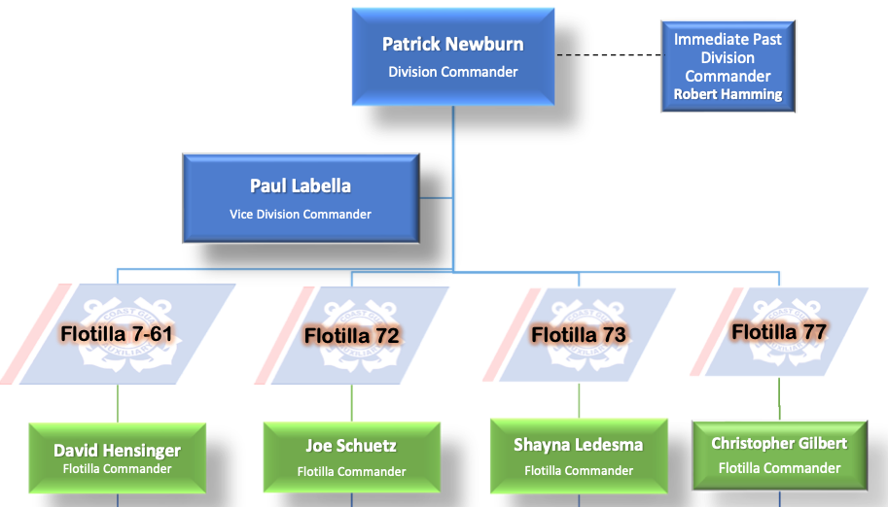
Division Board (7)

Slide 50
10 Min. BREAK

Slide 51
Flotilla Organization

Slide 52
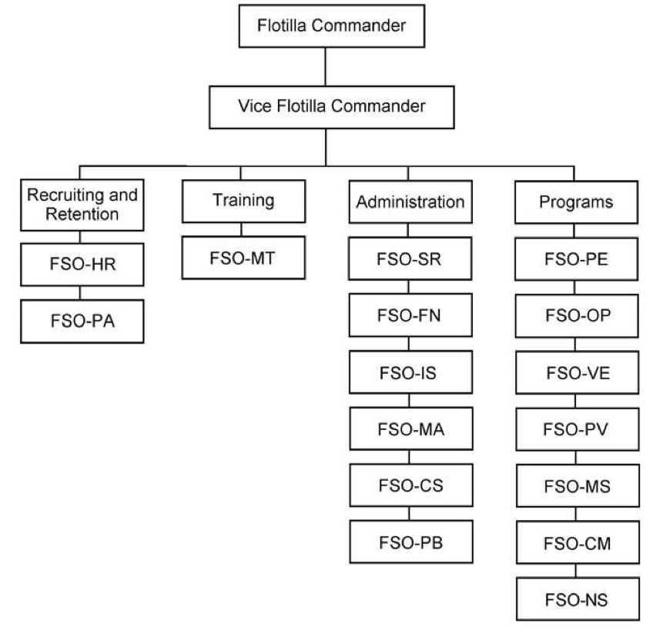

Slide 53
Appointing Staff
The FC should appoint appropriate staff to conduct the business of the flotilla including finance, record keeping, information services, and other administrative areas; to manage recruiting/retention and training; and to conduct programs as desired.
Consult closely with the VFC when making your selections. Remember, the VFC will be acting as chief of staff and working closely with those selected.

Slide 54
Appointing Staff
After appointing the flotilla staff, meet with them with the VFC present. Let FSOs know how you plan to operate and what you expect of them. It is especially important that FSOs understand to whom they must report.
The VFC exercises direct staff supervision, and FSOs must understand that the FC will fully support the VFC.

Slide 55
Appointing Staff
Even though the VFC manages the flotilla staff, the FC, by virtue of position, still bears responsibility for flotilla programs.
Process
Meet or Phone to Offer & discuss the Job
Mail 2 documents to the FSO:
General Duties of Flotilla Staff Officers
Specific Duties of Officer’s Function

Slide 56
Appointing Staff
Do not simply hand FSOs their job descriptions and expect them to make it happen!
Explain the job
Explain the goals, discuss expectations
Explain the paperwork
Help them get the training needed

Slide 57
Critical Appointments
Sample staff appointment letters and duties are in the Flotilla Procedures Manual
Each Flotilla must have the following appointed staff: SR, FN, MA, MT, HR, IS
Each Flotilla must also have at least one of the following operational staff: PV, OP, PE or VE

Slide 58
Critical Appointments
(Top 5)
FSO-FN (Finance)
FSO-HR (Human Resources)
FSO-IS (Information Services)
FSO-MT (Member Training)
FSO-SR (Secretary/Records)

Slide 59
RBS Appointments
“Job Number One”
FSO-PE (Public Education)
FSO-VE (Vessel Examination)
FSO-PV (Program Visitor)
…There are other Program Area Appointments that will help get the work done… Your Flotilla goals will guide these appointments

Slide 60
Change of Administration

Slide 61
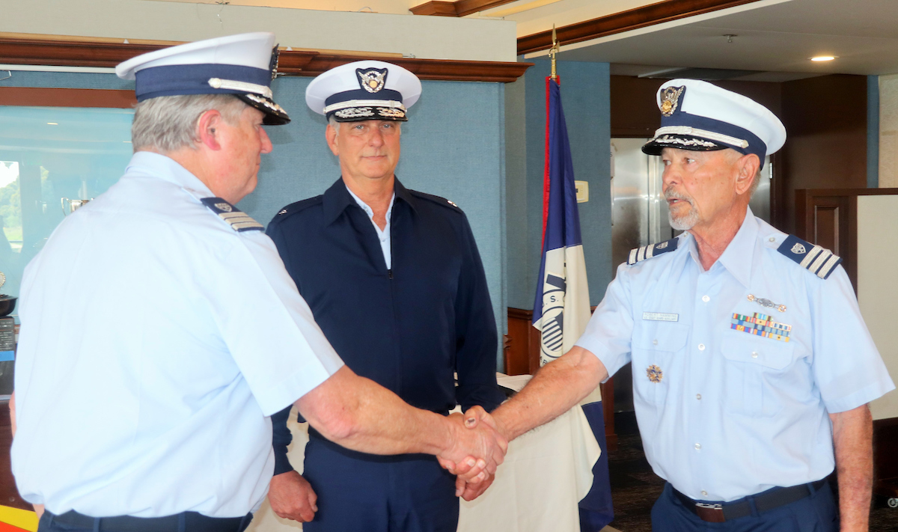
Change of Administration

Slide 62
Before End of Year
Document Review:
Change of Administration

Slide 63
Before End of Year
Transfer of Records and Documents (December 15)
Complete Staff Appointments and prepare & send Form 7007: Annual Unit Officers Report (December 20)
Any new or Change of Officers must be reported Form 7006: Change of Officer Report
Staff Officer Appointment letters sent by January 1

Slide 64
Before End of Year
Before 1 January have a meeting with your VFC to coordinate your administrative expectations
Before the first Flotilla meeting review “Roberts Rules of Order”, in the Flotilla Procedures Manual
Prepare an AGENDA for each Flotilla meeting. Send-out one week prior to meeting

Slide 65
Auxiliary Structure

Slide 66
Auxiliary COLM

Slide 67
District 11sr
District 11SR has 47 flotillas organized into 9 divisions
Southern California, Arizona, Southern Utah
Same District Overlay as US Coast Guard
Over 1000 Auxiliarists

Slide 68
District COLM

Slide 69
Auxiliary Finances

Slide 70
Finances SOP
Document Review:
Auxiliary Financial and Materials Control SOP
(April 2024)

Slide 71
Finances
FINANCE REPORT 7025 – Due January 25
The Financial Report of an Auxiliary Unit ANSC 7025 (CGAUX-23) must be sent to the DCDR by 25 Jan.
This report is the responsibility of the outgoing FC.
Must be signed by the outgoing and incoming FSO-FN.
The Unit Inventory must be signed by the outgoing and incoming FSO-MA.
Both must be signed by the outgoing and incoming FCs confirming report is complete and accurate

Slide 72
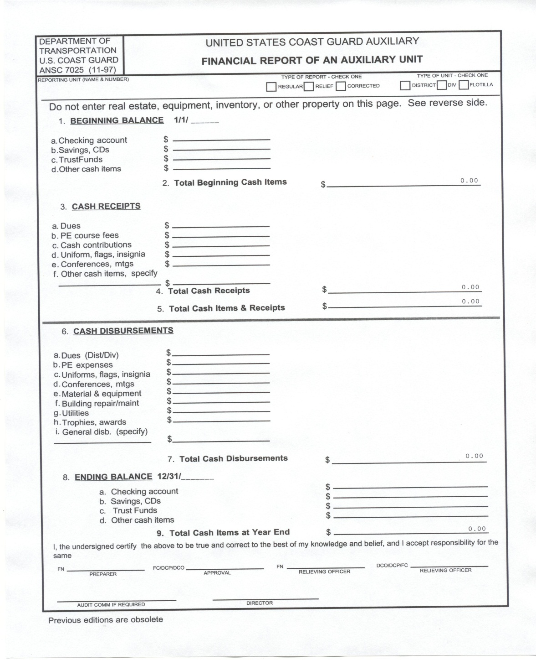
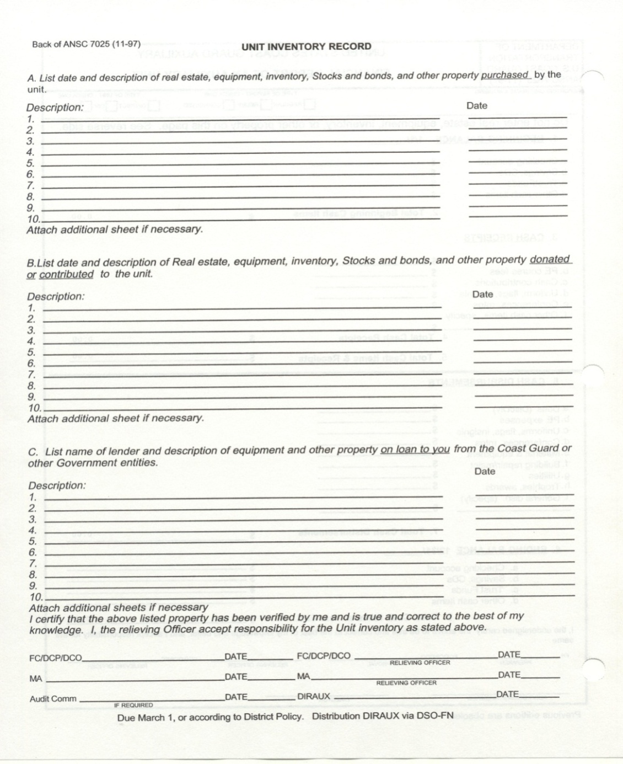
Finance Report - 7025

Slide 73
SOP Highlights
The Coast Guard Auxiliary is recognized by the Internal Revenue Service (IRS) as a government entity. It has never been a not-for-profit entity or any other type of charitable organization.
Budget shall coincide with the conventional calendar year, January 1 thru December 31
Establish the unit’s annual budget in advance of the new fiscal year. however it must be approved within the first three months of the fiscal year

Slide 74
SOP Highlights
Flotilla monthly bank statements shall be reviewed by the Flotilla Commander (FC) and the FSO-FN to verify that all transactions are in order.
FC and FSO- FN shall be designated as joint signatories for all of the unit’s bank accounts
Special attention shall be made to ensure funds collected from PE course fees are tracked separately
PE revenue may not be used for social or fellowship activities.

Slide 75
SOP Highlights
FSO-FN shall prepare a financial report at each monthly unit meeting
Conduct an annual audit and complete Form 7025
Appoint Audit Committee (3); review specific composition requirements listed in Financial SOPs

Slide 76
Flotilla Meetings

Slide 77
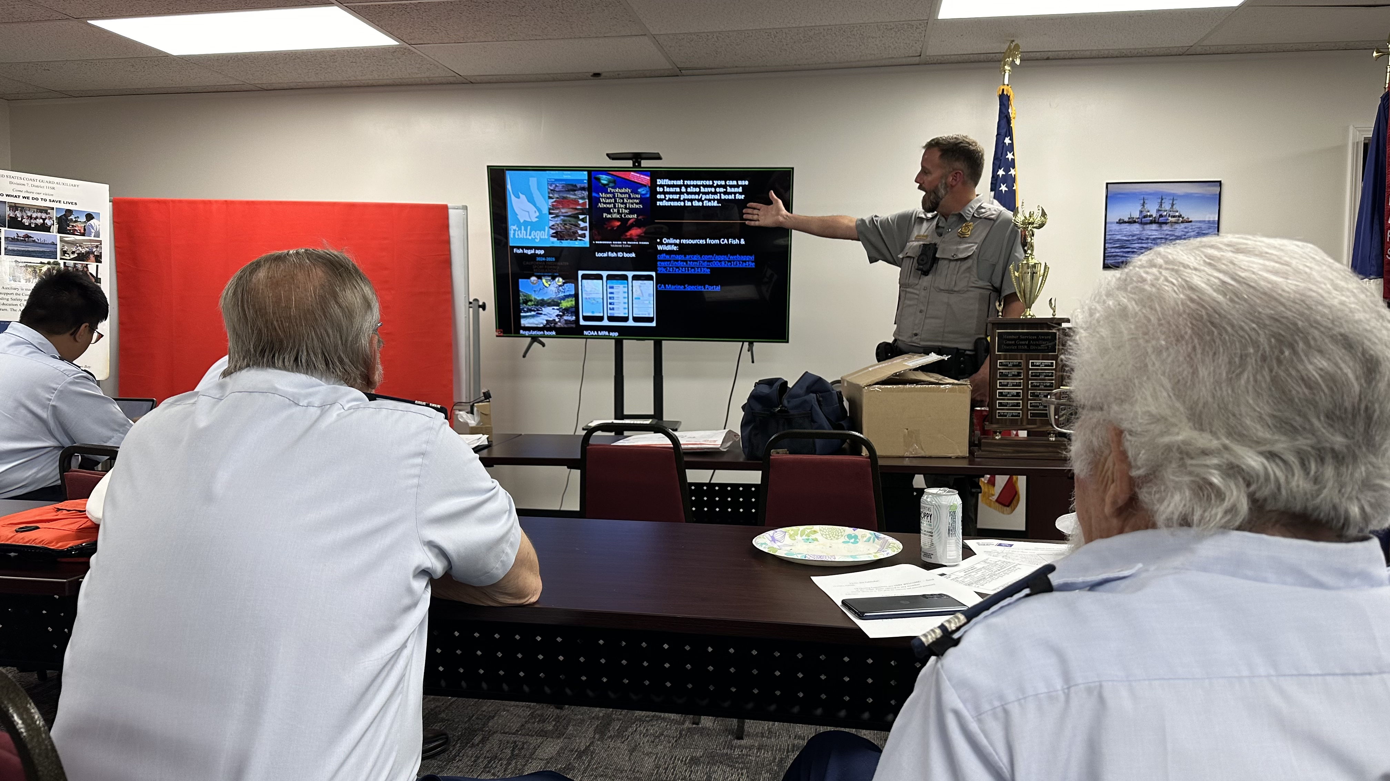
Flotilla Meetings

Slide 78
Flotilla Meetings
Document Review:
Flotilla Procedures Guide

Slide 79
Flotilla Meetings
FC must obtain an Assignment to Duty (ATD) as approved from DIRAUX. Use D11s website for online form, 14 days prior to unit event.
There are consequences for non-completion of CORE Training. REYR = Unable to attend in-person meetings or activities …No ATD! (All members must complete every 5 years).

Slide 80
Flotilla Meetings
FC must Attend and preside over flotilla meetings, and notify the VFC as early as possible when unable to attend.
Use Roberts Rules of Order for motions, voting
Follow the Agenda!
Usual meetings last 90 minutes
Monthly Meeting need an Agenda sent to member at lease one week prior.

Slide 81
Flotilla Meetings Content
Value, respect, and celebrate every member’s accomplishments and contributions. Each flotilla meeting should include several instances of informal recognition to individual members.
Remember to have fun. Include fellowship opportunities in every activity
Most flotilla meetings include oral reports from the staff. Keep reports informative and useful.
Present and approve minutes of prior meeting
Present approve monthly finance report

Slide 82
Flotilla Meetings Content
Include Member Training at every meeting. -- 30 minutes -
30 minutes of training is the minimum to define a meeting as a “training” meeting.
Training meetings are covered by USCG insurance during the meeting.
Why Training? Insurance coverage, interest to members, better trained and informed membership.

Slide 83
Flotilla Meetings Content
Include Member Training at every meeting.
Training Topics Ideas:
Invite guest speaker and special guests
Bomb Squad
Red Cross – Disaster Preparedness
LAKE/RIVER/HARBOR Law Enforcement
Marine Safety, Environmental awareness
NOAA – NATIONAL WEATHER SERVICE
Instructor/ PE training
Program Visitor (PV) Training
Vessel Examiner (VE) Training

Slide 84
Information Services & Reporting

Slide 85
INFORMATION SERVICES
SO-IS a primary information resource for you.
If your flotilla has no FSO-IS, Division SO-IS can adopt that role.
SO-IS can help train your members on AUXDATA II.
For those untrainable members, SO-IS will accept hours in any form, but they must provide Code, Mission Date, Hours, and Description.
Report hours promptly. SO-IS will not approve hours over three months old (90 days).
Mission hours, other than 99 code hours, should be reported for the day of the mission.
Accumulate your 99 code hours each month, and report them using the first of the month.

Slide 86
Typical Reports
FSO-IS should constantly remind members to log End of Month hours promptly
Member Roster – name, member #, email, phones
AUXCT Matrix – Green, Yellow, Red
Uniform Inspections – date of last inspection
Division 7 Flotilla Mission Detail
By member, mission, hours, # PVs, # VEs

Slide 87
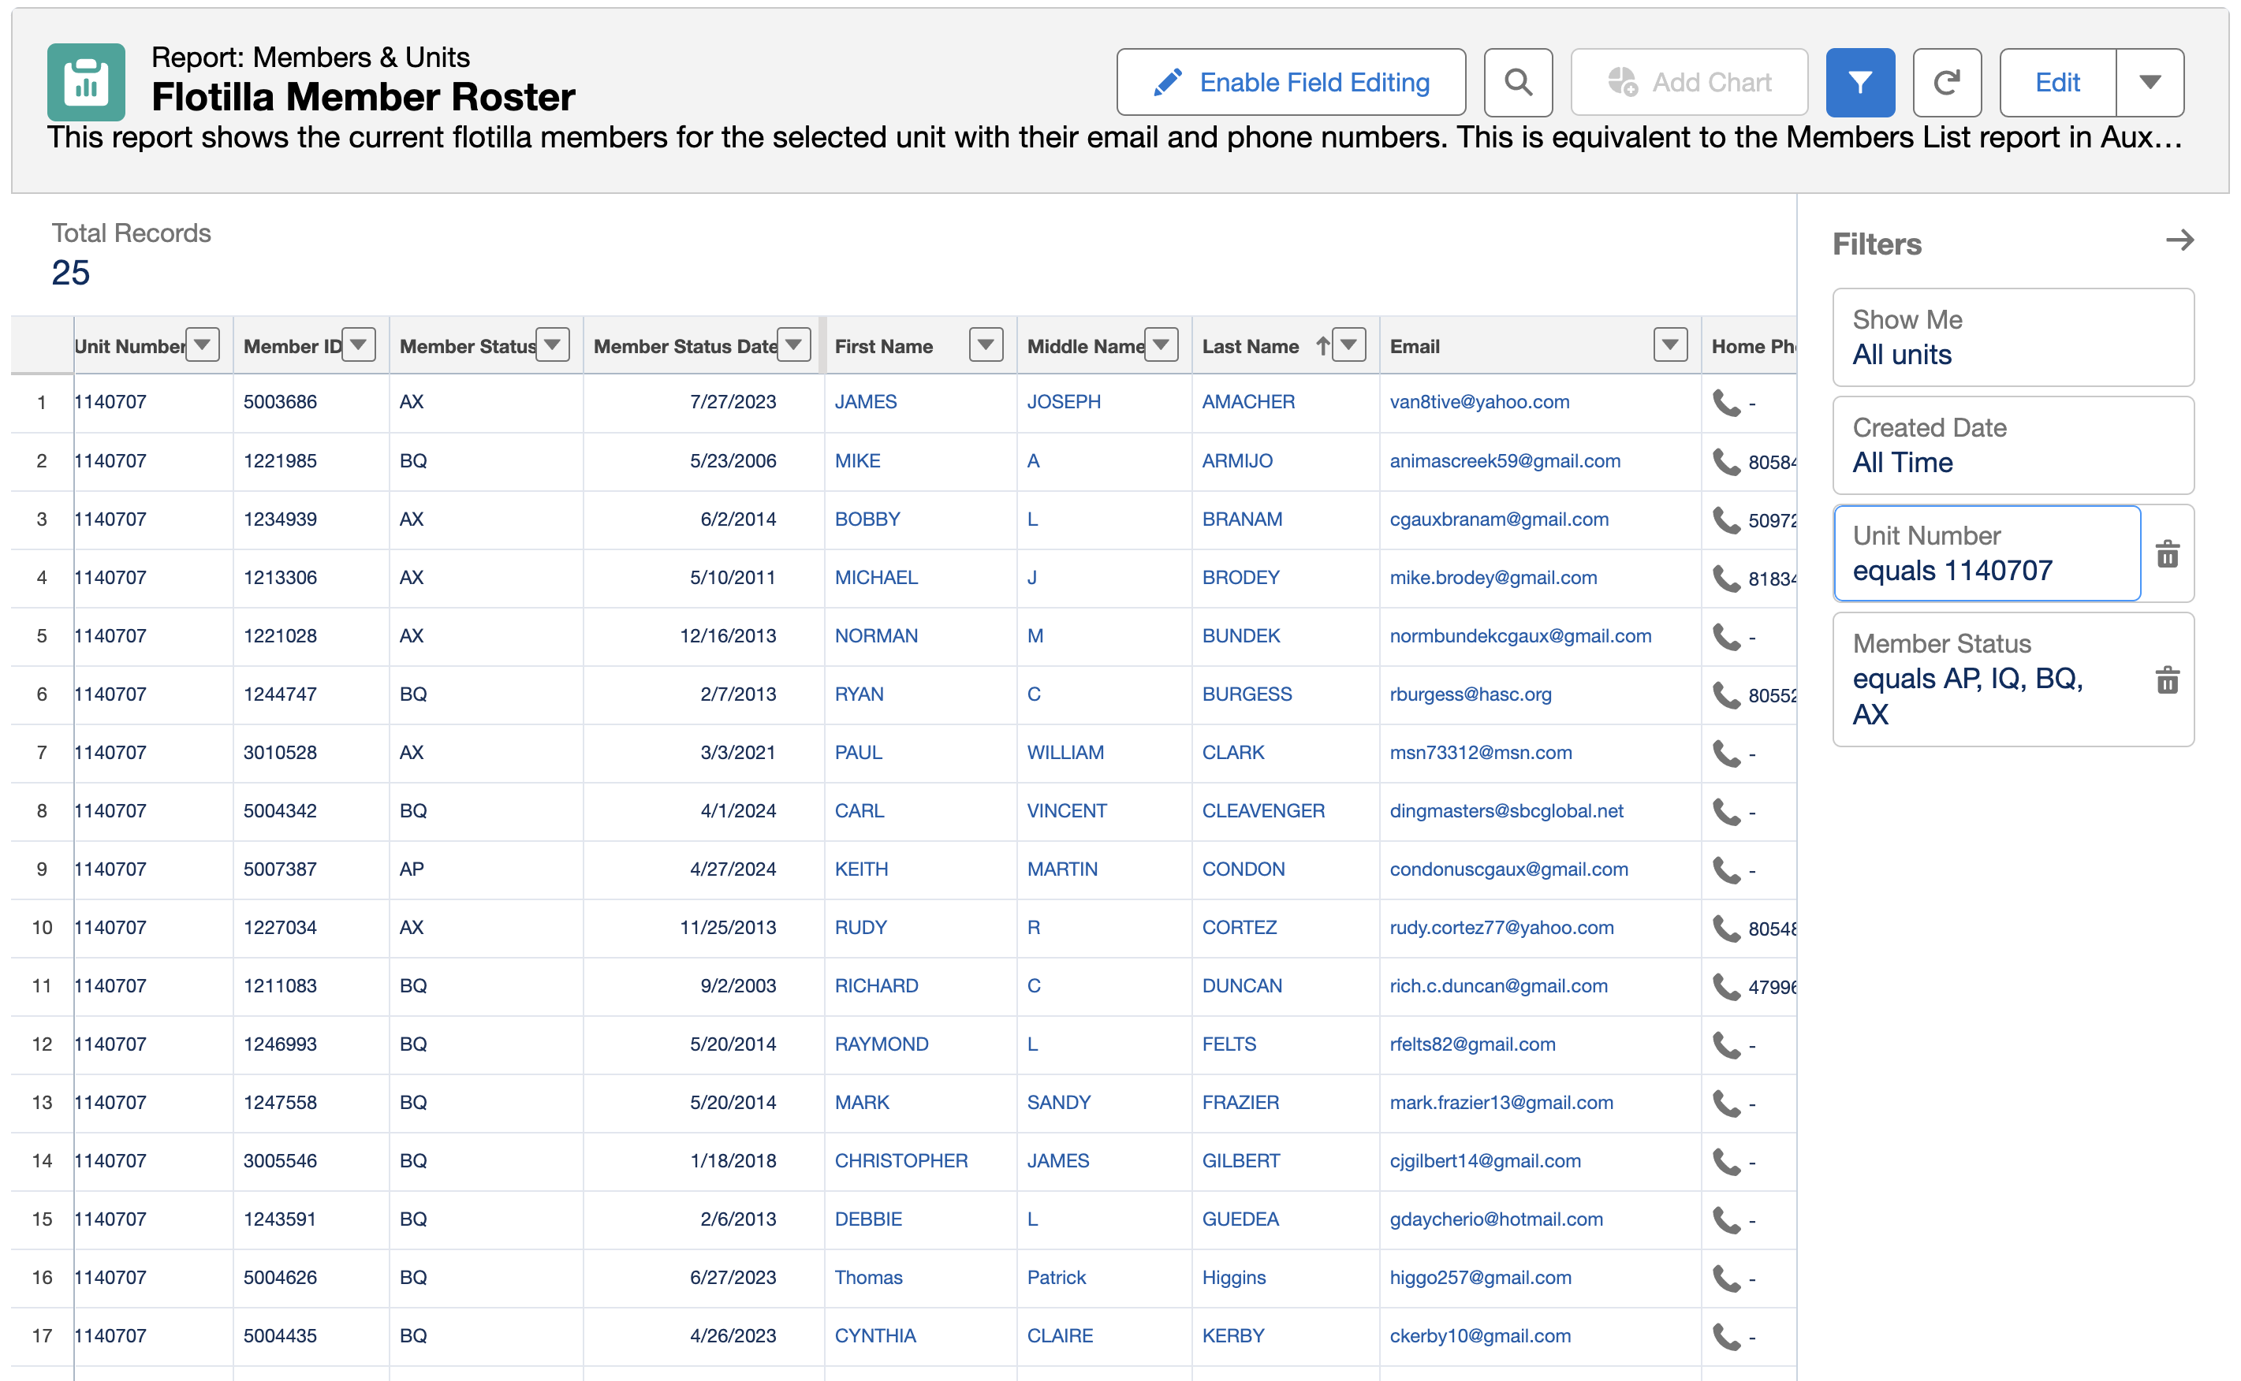
Member Roster

Slide 88
AUXCT Matrix

Slide 89
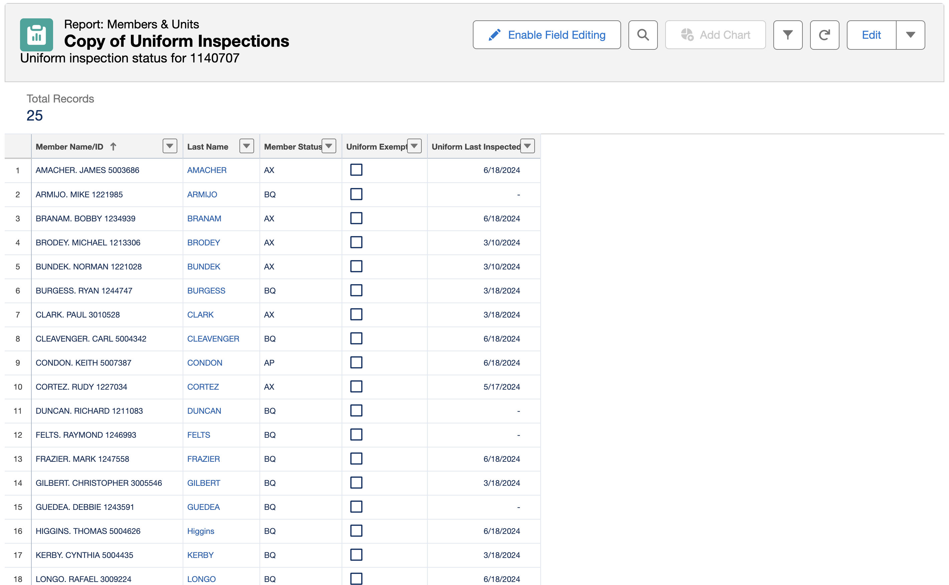
Uniform Inspection

Slide 90
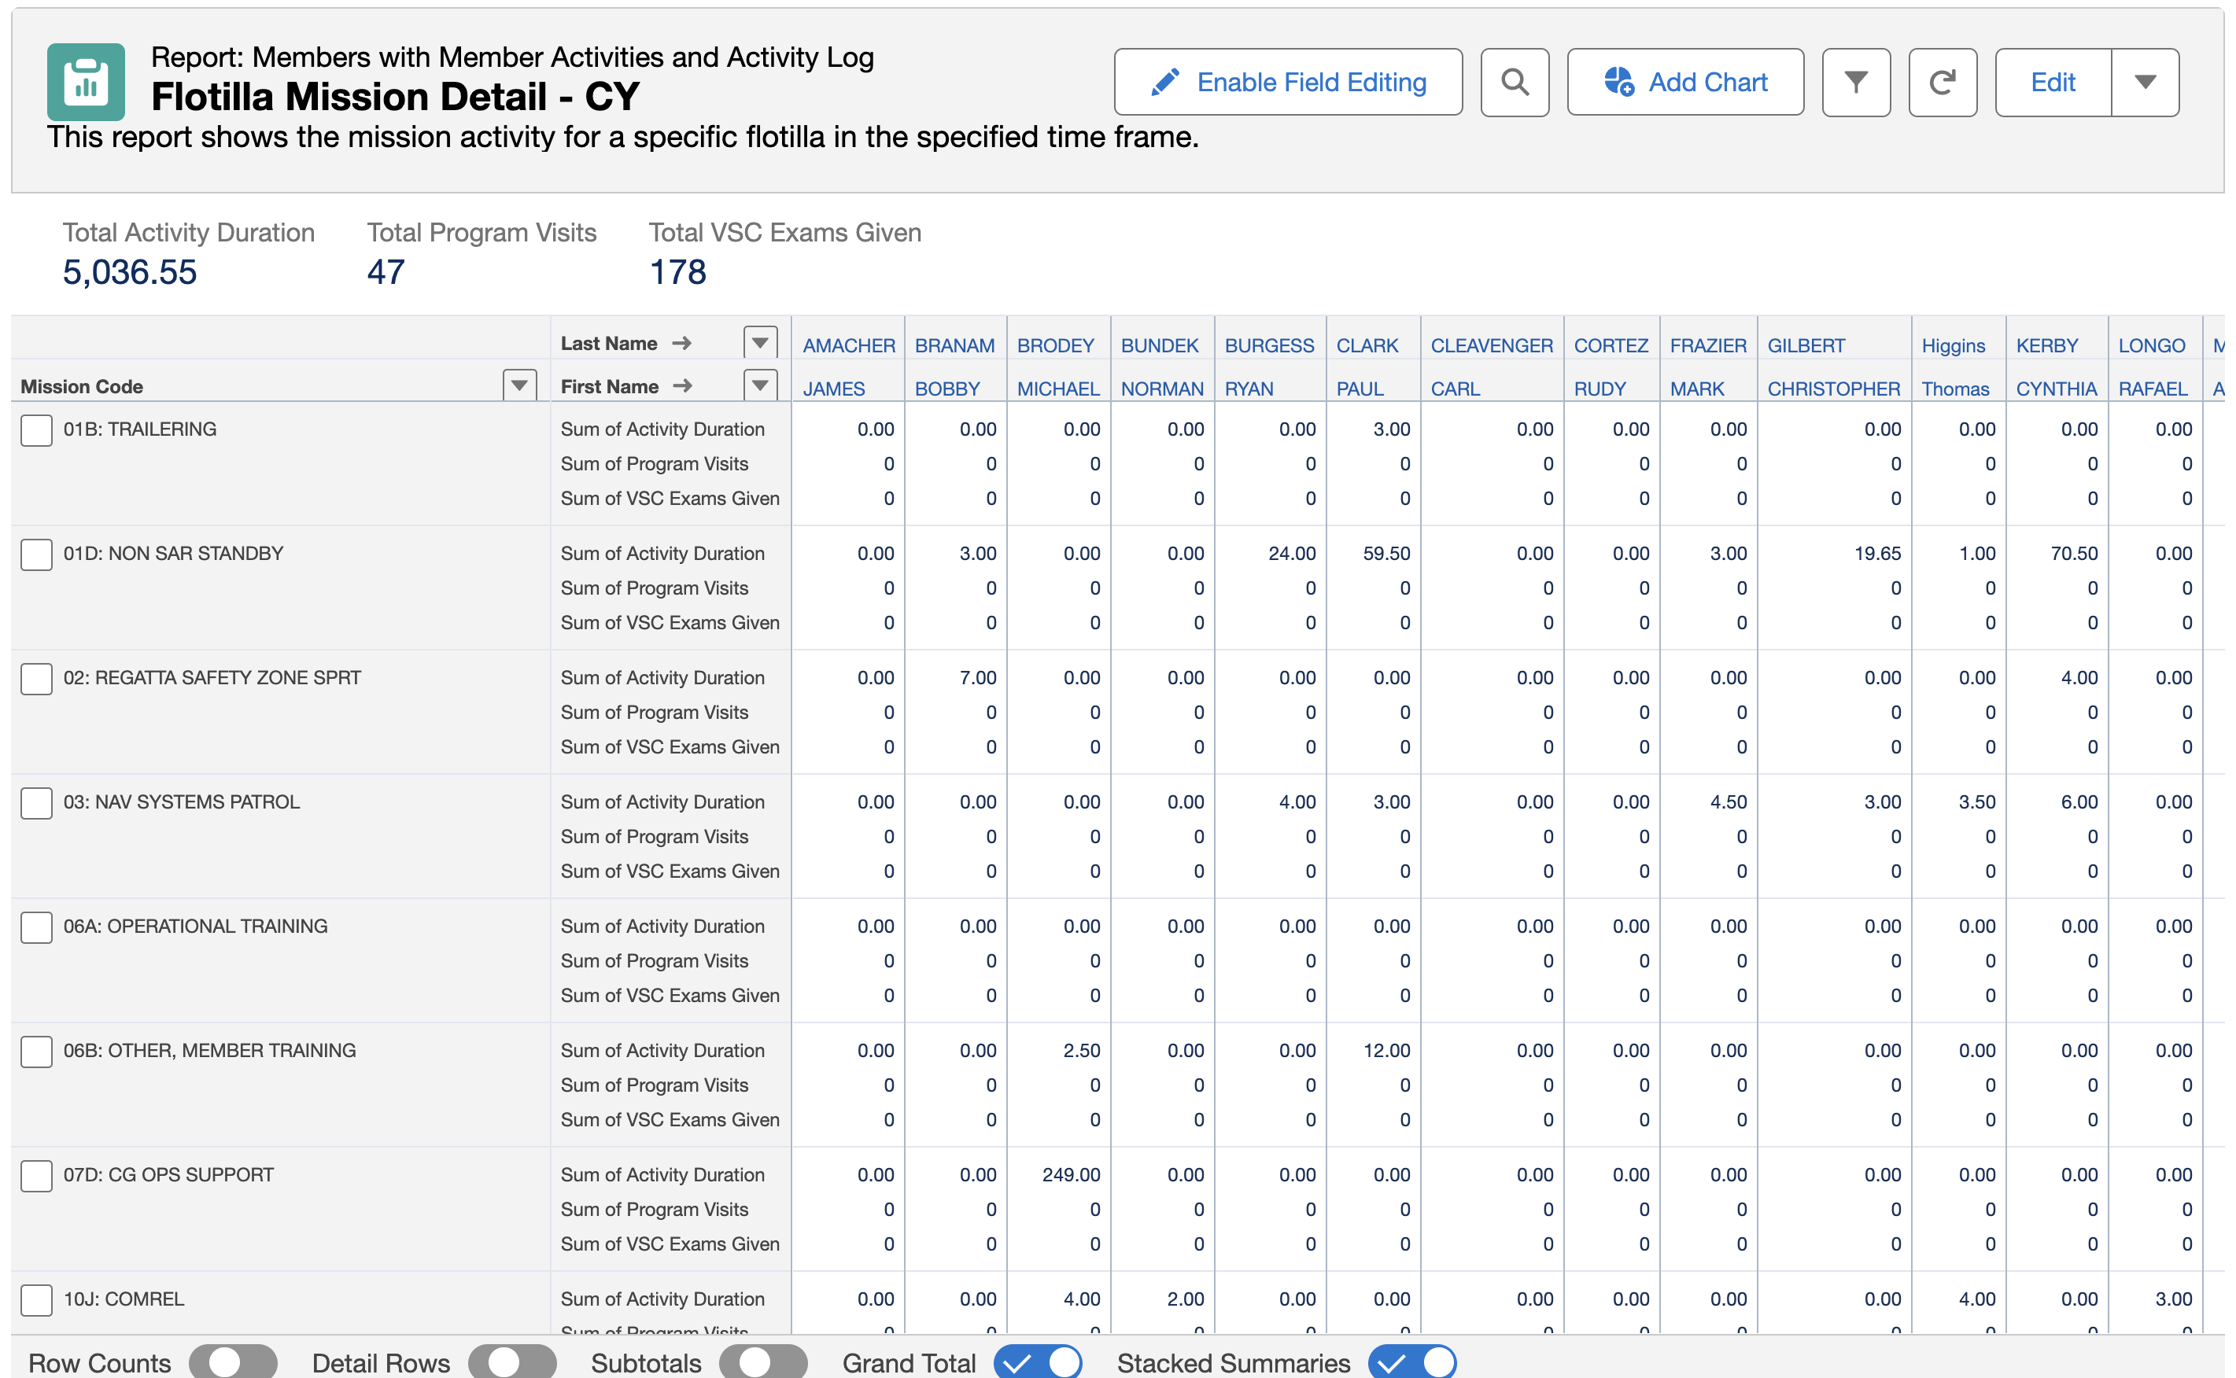
Mission Detail

Slide 91
AUXILIARY UNIT COORDINATOR (AUC)

Slide 92
AUXILIARY UNIT COORDINATOR (AUC)
All contacts with the CG should go through the appropriate AUC.
We are always on the lookout for members with skills that can help the stations – radio watch standers, painters, carpenters, ???
Radio Watch Standers are always in demand but must be prepared to devote considerable time to train at the station, and to stand regular watches.
AUC maintains the calendar for use of the ATD (Aux Training Deck).

Slide 93
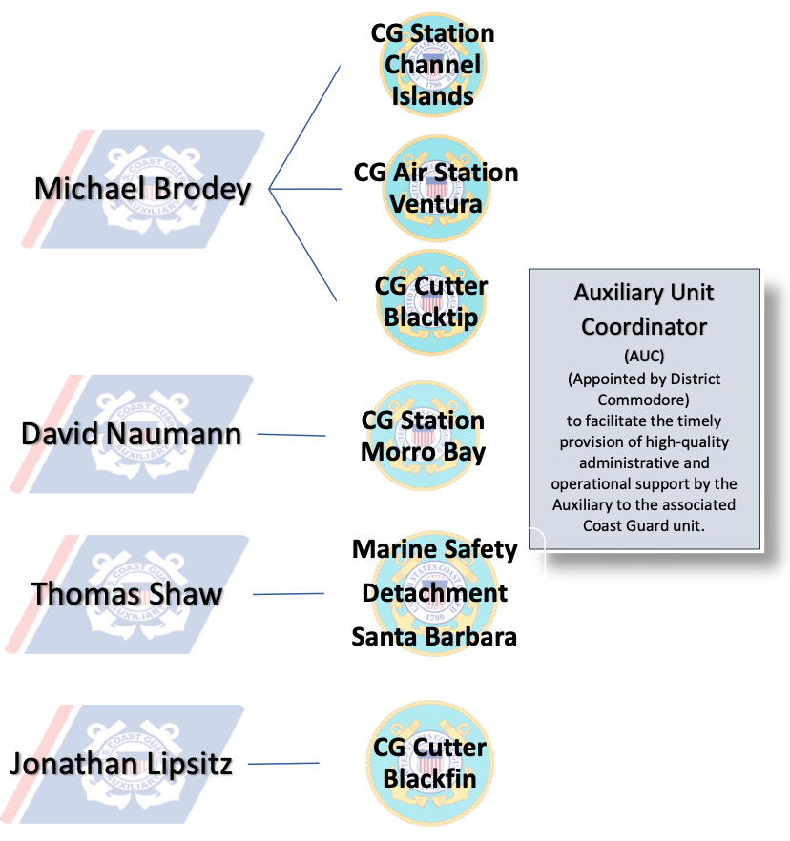
AUXILIARY UNIT COORDINATOR (AUC)

Slide 94
LUNCH BREAK

Slide 95
Member Communications

Slide 96
Effective Communication
Effective communication occurs when the sender transmits completely, and the receiver interprets exactly as the sender intended.

Slide 97
Communication
Success depends on our ability to understand each other, respect each other, and form an effective organization that rewards everyone’s efforts.
The successful leader uses human relations skills to work effectively and develop a cooperative spirit among members.

Slide 98
Effective Communication
Writes succinctly and produces written materials that are clear and articulate.
Speaks in concise, effective, organized manner; tailored to the audience and situation.
Listens attentively, understands and absorbs the message of others.
Observes body language and other forms of non-verbal communication.
Communicates to members and transmits member concerns/ideas to elected and appointed leaders.

Slide 99
Effective Communication
Identify and Avoid the Barriers to Effective Communication.
Send Clear, Understandable Messages.
Listen Actively to Others. Solicit Meaningful Feedback.
Adapt to Style, Gender, and Cultural Diversity.
Give Appropriate Feedback.
ALWAYS BE RESPECTFUL

Slide 100
Communication
WRITTEN
Promptly read, endorse/sign, and forward mail, as appropriate.
Review your calendar and send reports in a timely manner.
Plan in advance for monthly/yearly events and let members know dates early.
Proof Read your emails before sending!
Proof Raed you emails before sending!
Proof Read you emales before sending!

Slide 101
Communication
Develop routine communications with VC & VFC.
Encourage Staff communications to the members, to other Staff Officers, and to Division Officers.
Follow the Chain of Leadership.

Slide 102
Mentoring New Members

Slide 103
Mentoring a Pathway to Leadership
INVOLVEMENT
RETENTION
MENTOR
RECRUIT
PATHWAY TO LEADERSHIP

Slide 104
Mentoring New Members by Communicating
Why Mentor?
New Members are frequently lost in the MORASS of Policies, Procedures, Processes and Acronyms.

Slide 105
Mentoring New Members by Communicating
Guiding, coaching, supporting.
Showing an interest—being there.
Share Information, knowledge and skills.
Develop a PLAN.
Setting Goals.
Monitor progress.
Giving Feedback.

Slide 106
Mentoring New Members
FSO- Member Training (MT) …To Do:
APPOINT Mentor(s) to New Members

Slide 107
Member Training

Slide 108
Core Training
MANDATORY TRAINING (Once every 5 years)
Required to be performed by all Auxiliarists during their first year of enrollment and then once every five years thereafter:
Suicide Prevention.
Security Education & Training Awareness.
Privacy Awareness.
Prevention of Sexual Harassment.
Sexual Assault Prevention.
Civil Rights Awareness

Slide 109
Core Training
MANDATORY TRAINING
Required to be performed only once by all Auxiliarists (new members during their first year of enrollment):
Introduction to Risk Management
Ethics Training
Influenza Training.

Slide 110
Core Training
Remember…..
If CORE training is not completed which require renewals every 5 years, members go REYR in ALL quals and hence, cannot be Assigned to Duty.
A member can not hold elected or appointed office.
A member will not receive awards, orders, or receive travel or fuel reimbursement without CORE Training and Intro to Risk Management course.

Slide 111
Member Training
FSO-MT - Member Training:
FSO-MT must be an Aux Instructor
Exercise staff responsibility and supervision over all matters pertaining to the flotilla member training program, and keep flotilla members informed of all developments in the program.
Maintain close liaison with the Division Member Training Staff Officer (SO-MT)
FSO-MT is not required to conduct all of the actual training.
Coordinate with the FSO-IS to assist in maintenance of member qualification records.

Slide 112
Awards

Slide 113
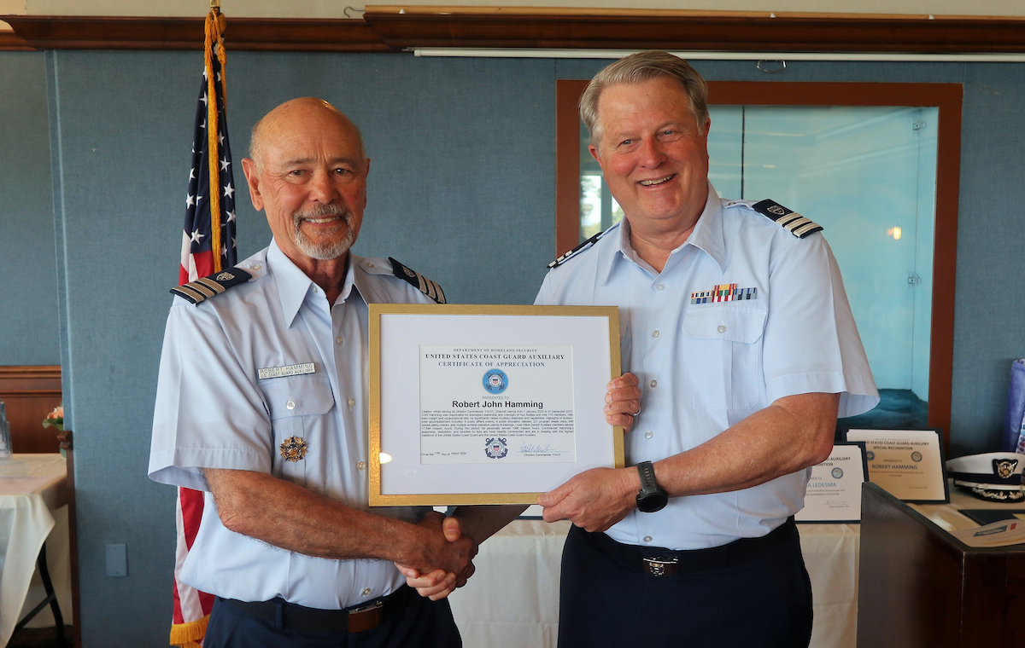
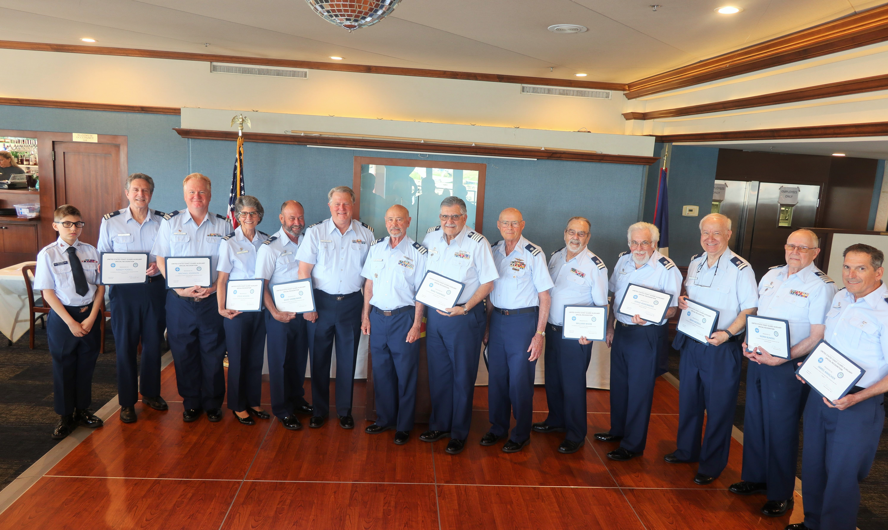
Member Awards

Slide 114
Member Awards
The recognition of Auxiliarists for their service through the presentation of timely and appropriate awards is essential to the success of the Auxiliary Program.
Auxiliary and US Coast Guard awards are the only “compensation” available to our members and need to be given out whenever an act or service warrant special recognition

Slide 115
Member Awards
Originator references the Coast Guard Medals and Awards Manual and AUX Manual to determine if a member’s action is worthy of an award. (D11s.org website)
Draft and submit the award through the COLM to the D11s Awards Board
D11 South Awards Board decides whether the award meets the criteria for approval.
Upon receipt at the DIRAUX Office, award is reviewed by office staff. If approved, the award is sent to the Director for final vetting, approval, and signature.

Slide 116
Member Awards
7 Steps (Development to Submission)
Gather Performance Data on the Member
Develop Bullets on member’s performance
Decide on the Level of the Award
Draft the Citation
Edit the Citation
Complete the CG-1650
Submit to the Chain of Leadership

Slide 117
Uniforms

Slide 118
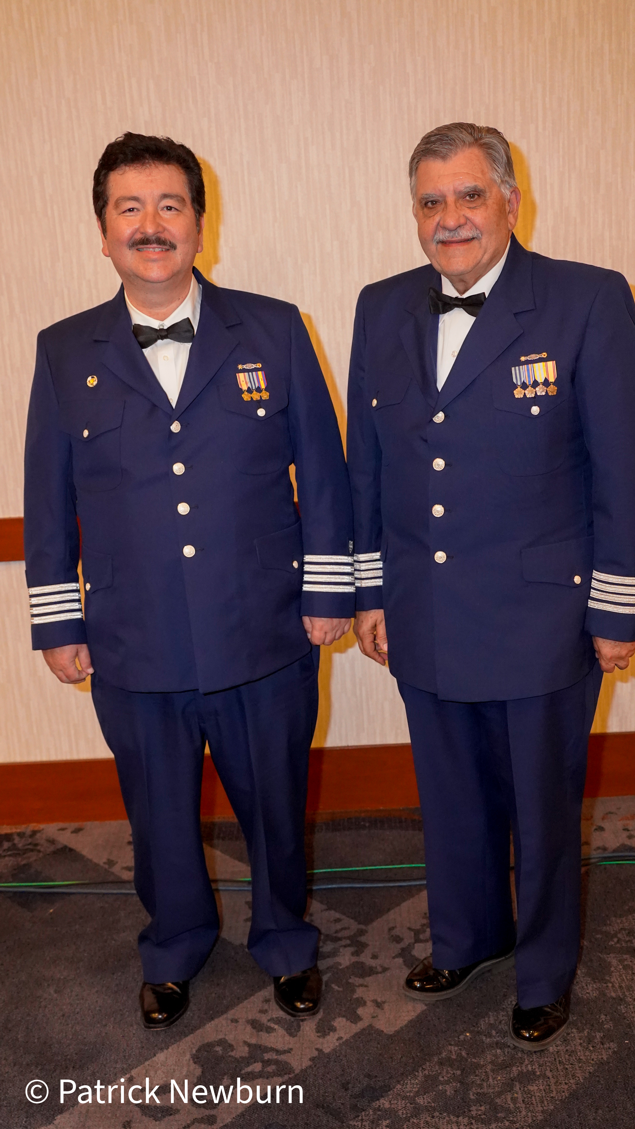
Uniforms

Slide 119
Uniforms
Document Review:
AUXILIARY UNIFORM AND APPEARANCE POLICY

Slide 120
Uniforms
Elected and appointed officers are expected to wear the uniform properly to set an example.
Auxiliarists in a membership status other than Approval Pending (AP) or retired shall undergo a uniform inspection each calendar year performed and validated for AUXDATA II entry purposes by their FC, VFC, IPFC, or other elected officer
If an Auxiliarist does not own an Auxiliary uniform, they may be recorded in AUXDATA II as exempt from this requirement.

Slide 121
Uniforms
Auxiliarists who do not undergo this uniform inspection requirement during the calendar year shall lose their currency and eligibility to be assigned to duty. (They shall be placed in REYR status!)
Uniform Inspection is an EDUCATIONAL process… NOT considered Pass/Fail. The Inspection may also be performed virtually.
Any uniform may be inspected: ODU, AWU, Trops, Service Dress Blue, or Blue Blazer Outfit

Slide 122
Human Resources

Slide 123
Enrollment Application
Document Review:
ALAUX 036-24 Auxiliary Enrollment Application Update

Slide 124
Conflict Resolution
Positive attitudes are contagious
Responsive actions to positive comments are almost always productive
Negative attitudes impact others in negative ways
Reactions to negative speech or actions are almost always unproductive

Slide 125
Conflict Resolution Process
Describe the specific conflict—get all facts
Name the people involved
Derive an action plan — assume there is a solution
Describe the results expected — eliminate emotion
Will a precedent be set?

Slide 126
Conflict Resolution Process
Apply logic
Accountability — find someone you trust to give you feedback on how things are going
Do you need help? — Chain of Leadership
REMEMBER: YOU WILL NOT PLEASE EVERYONE.

Slide 127
Conflict Resolution
FCs are the front-line for diagnosing and handling potential disciplinary matters.
Chapter 3 of the AuxMan discusses how to use counseling, Letters of Caution, Letters of Reprimand and other forms of disciplinary actions, including who can use them, and who can support the FC when needed.
Consult with your DCDR before taking formal actions.

Slide 128
Conflict Resolution
FCs must live by the oath that all Auxiliarists take to "abide by the governing policies established by the Commandant of the U.S. Coast Guard".
Take action early on and document it when dealing with disciplinary matters.

Slide 129
Conflict Resolution
Awareness of these provisions and the specific Commandant policy statements for:
the Auxiliary Policy Statement;
the Equal Opportunity Policy Statement; and,
the Anti-Discrimination and Anti-Harassment Policy; are essential elements that FC’s must share with their Flotilla.

Slide 130
Legal Issues
Assignment to duty
AUXMAN Chap 5.J. states: an Auxiliarist is considered a Federal Employee and MAY be entitled to benefits coverage and protection when:
Qualified for duty (quals current)
Properly assigned to duty
Acting within the Scope of Employment

Slide 131
Legal Issues
Assignment to duty
Assignment to Duty
Auxiliarists that meet the above criteria MAY be covered for:
Personal Injury and/or death
Protection from Third party claims for:
Liability to injured parties
Property damage
Property damage to Auxiliary Facilities that are under orders
Coverage DOES NOT extend to personal property of an Auxiliarist.

Slide 132
Legal Issues
Assignment to duty
The Auxiliary Manual specifically excludes en-route coverage to/from Flotilla meetings per ref (b) Ch 5.J.1.
Recommend scheduling a member training session at meetings, then the Auxiliarist is en-route to a training session, and that MAY be covered, provided:
The training is on the agenda
Members have been notified of the training.

Slide 133
Legal Issues
Contracts
Only the Unit Commander has the authority to sign contracts and similar agreements.
This authority cannot be delegated.
Contracts must be reviewed and approved by the DSO-LP or ADSO-LP.
Contracts and agreement that do not conform to rules, leave the signing Auxiliarist personally liable.

Slide 134
Legal Issues
DONATIONs/ SOLITATIONS
All Flotilla, Division and District units are authorized to solicit and accept money or equipment/materials from community charitable organizations, commercial firms and businesses, provided such donors are strictly local in nature
Go to DCDR for guidance from ADSO-LP

Slide 135
BREAK

Slide 136
Flotilla Evaluation

Slide 137
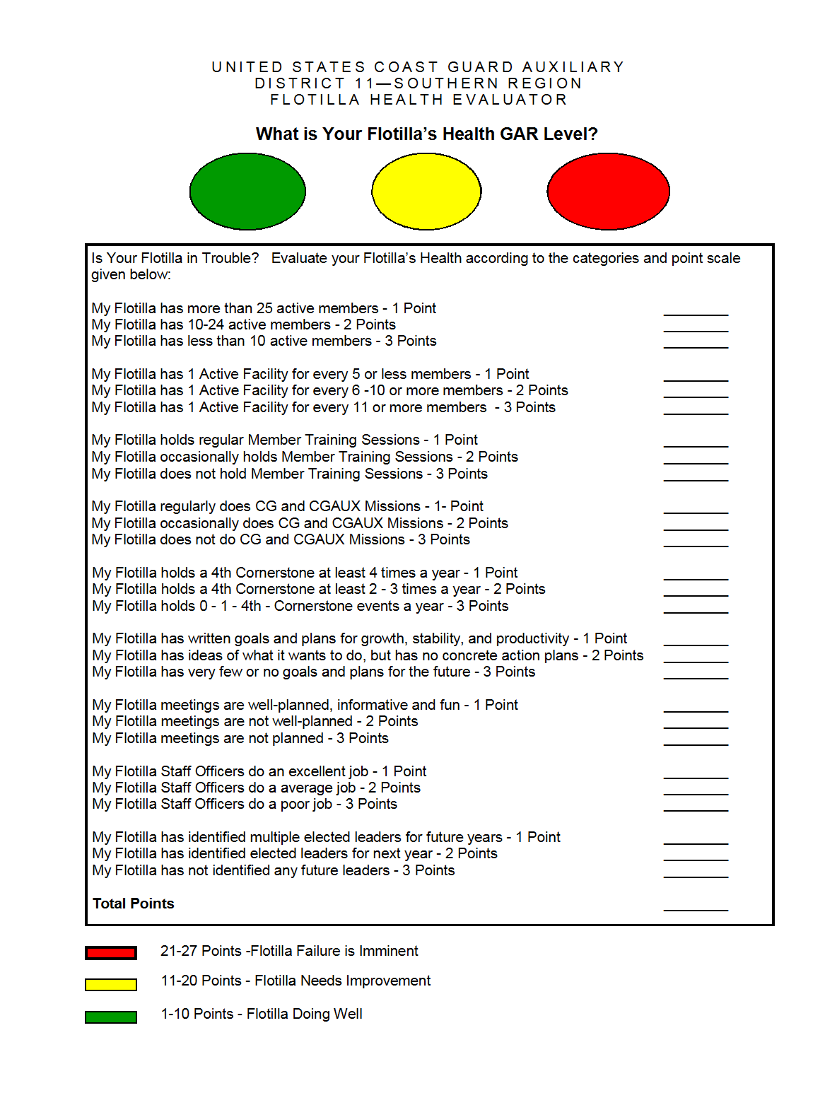
Flotilla Risk Calculation Worksheet

Slide 138
Flotilla Risk Calculation Worksheet
Document Review:
Flotilla Health Evaluation - GAR
Know Your Members Quadrant

Slide 139
Flotilla Risk Calculation Worksheet
GAR is based on a team discussion to understand and evaluate the risks attendant to flotilla success and how they will be managed. Risk management is what is important; not the ability to assign numerical values or colors to risk elements.
The GAR model should be used as part of planning for flotilla success, and should be continually reassessed as we reach milestones within our plans, or as elements change.

Slide 140
Wrap-up

Slide 141
CONGRATULATIONS Thank You For Attending and Participating in the 2024 Flotilla Elected Leader Academy

