Slide 1
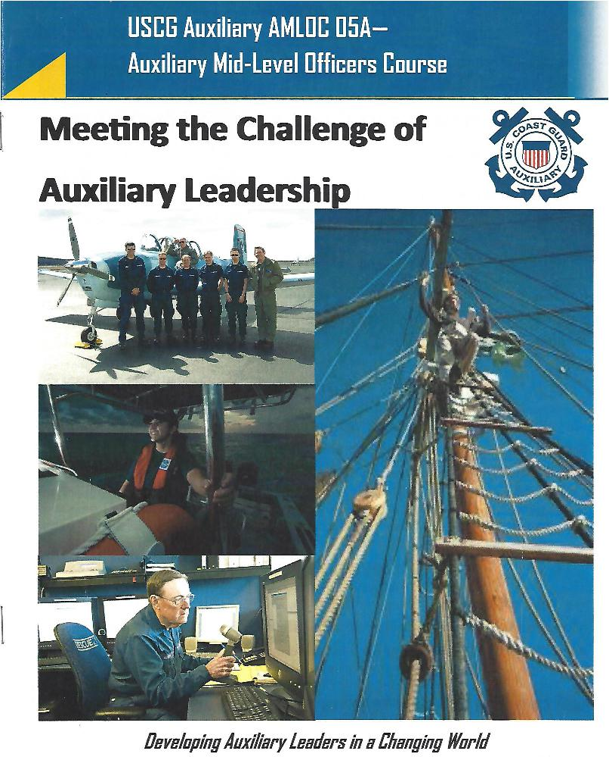
A SHARED VISION

Slide 2
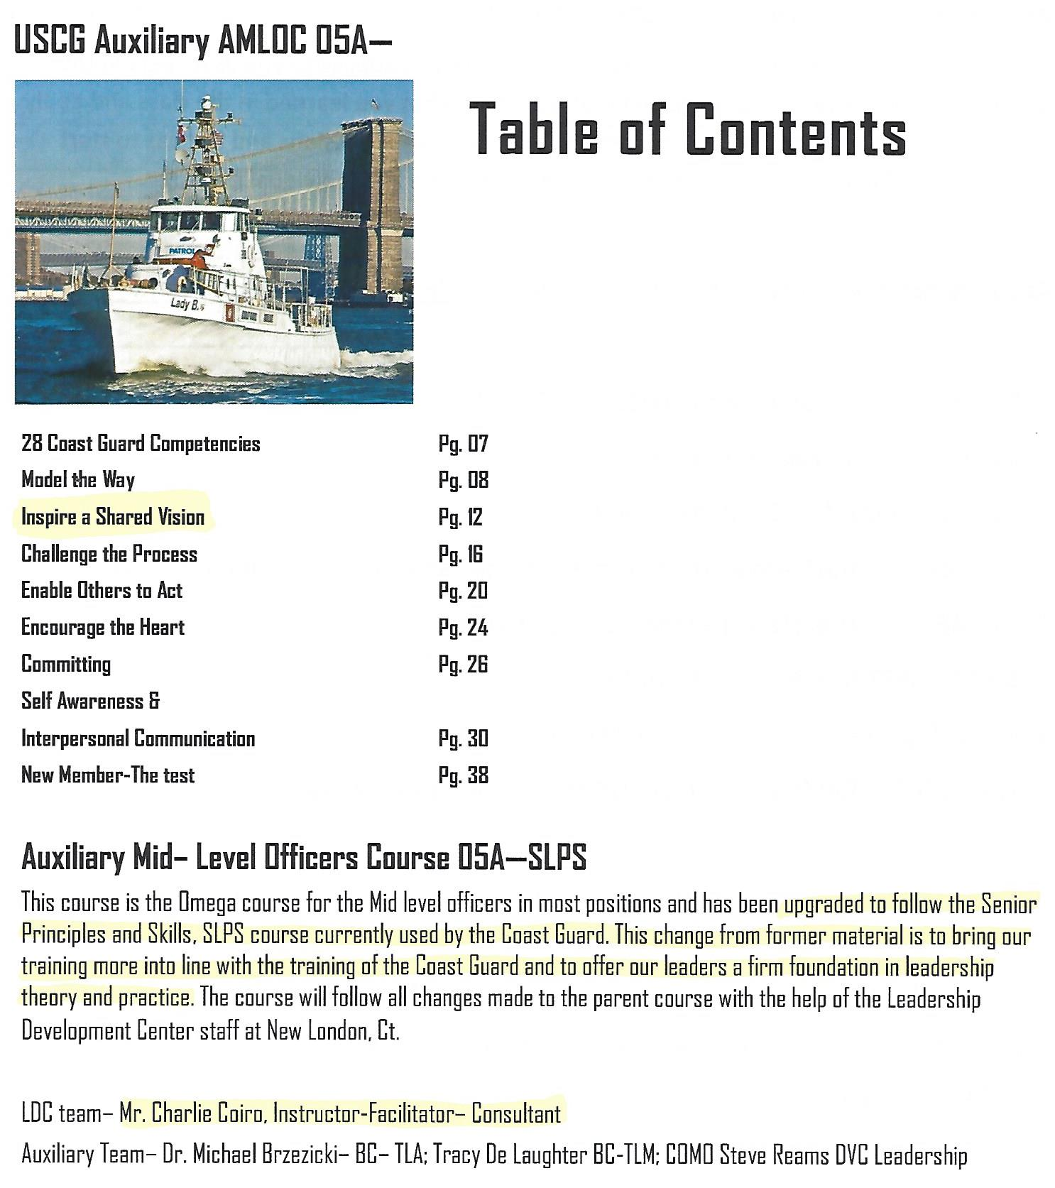
A SHARED VISION is important
to the COAST GUARD

Slide 3
A SHARED VISION is very
Important to the Coast Guard
I attended a C-School at the Sand Island, Hawaii Coast Guard Base. This was the first Auxiliary AMLOC (mid-level officers) class using the Coast Guard’s mid-level officer training program. Charlie Coiro, lead instructor from Coast Guard Leadership Development Center, was the instructor. The purpose for this new material is to have the Coast Guard and Auxiliary have the same training. One of the main take-always from the class was the idea of a SHARED VISION. A SHARED VISION unites and provides a common goal for groups of people.

Slide 4
a SHARED VISION
has an unlimited amount of people power once tapped!

Slide 5
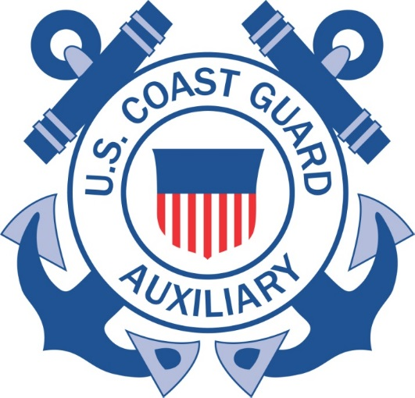
←- Our very own District logo
as well as our Auxiliary logo are symbols of SHARED VISIONS – we just have to understand the vision.
WE DO WHAT WE DO TO SAVE LIVES

Slide 6
Now, let’s look at the Coast Guard’s example of a SHARED VISION
A BM2 takes a working party of three SNs to paint their CG Cutter. All three SNs have the same paint, brush and instructions to paint their assigned area.
SN#1 paints bow; SN#2 mid ships; SN#3 stern

Slide 7
the Coast Guard’s example of a SHARED VISION
Two hours later, the BM2 comes back to inspect the work. He askes each SN the same question:

Slide 8
the Coast Guard’s example of a SHARED VISION
“SN#1-- What are you doing?”
SN#1 says: “I’m painting the bow BM2!”

Slide 9
the Coast Guard’s example of a SHARED VISION
“SN#2-- What are you doing?”
SN#2 says: “I’m Saving the Cutter BM2!”

Slide 10
the Coast Guard’s example of a SHARED VISION
“SN#3-- What are you doing?”
SN#3 says: “I’m Saving LIVES BM2!”

Slide 11
the Coast Guard’s example of a SHARED VISION
Three different answers for the same job?
Why is that?

Slide 12
the Coast Guard’s example of a SHARED VISION
The differences are the attitude and understanding of the role each SN plays in one of the main missions of the Coast Guard
SAVING LIVES!

Slide 13
the Coast Guard’s example of a SHARED VISION
The SHARED VISION of keeping the Cutter ready and seaworthy to Save Lives was
totally understood by SN#3.
He knew his painting was “Saving Lives”.

Slide 14
the Coast Guard’s example of a SHARED VISION
SN#2 had an understanding that the
Cutter had to be seaworthy.
He KNEW his painting was “saving the Cutter”.

Slide 15
the Coast Guard’s example of a SHARED VISION
SN#3 only understood it was
supposed to be painted
“white”

Slide 16
the Coast Guard’s example of a SHARED VISION
This may work for a Cutter’s working party
BUT, how does this apply in
an actual emergency where
many lives are at stake?

Slide 17
the Coast Guard’s example of a SHARED VISION
The Katrina Story
CG Rear Admiral Robert Duncan’s assessment
of the Coast Guards response to Katrina. Where over 24,000 + lives were saved.

Slide 18
The Auxiliary should have all members understand what they do contributes to “Saving Lives”
Let’s look at our three SNs as three Auxiliarists; all
three pay their dues and get uniforms and are excited
about joining --- then this happens…
Member #1 does not show up for anything
Member #2 only goes to Flotilla meetings
Member #3 gets certified, holds office, goes to meetings
and attends this workshop

Slide 19
We Do What We Do To Save Lives
It is your job as Flotilla leaders to have your members understand that any job they do “Saves Lives”.
We all joined the Auxiliary for some reason. All of you
in this room stayed true to why you joined. However,
most of the District’s members have lost touch with
their reason(s) due to circumstances and not under
standing what their time and efforts can do to:
SAVE LIVES
.

Slide 20
A SHARED VISION is very important
to the Coast Guard and Auxiliary.
We Do What We Do To Save Lives!
BUT, something must be done first…

Slide 21
Let’s not Let this happen!

Slide 22
Communicate!
Say it!
Write it!
Talk about it!
Believe it!
WE DO WHAT WE DO TO SAVE LIVES

Slide 23
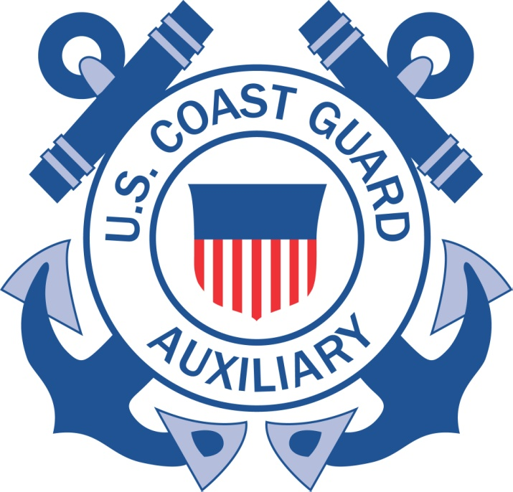
WE DO WHAT WE DO TO SAVE LIVES

